Slide 1
























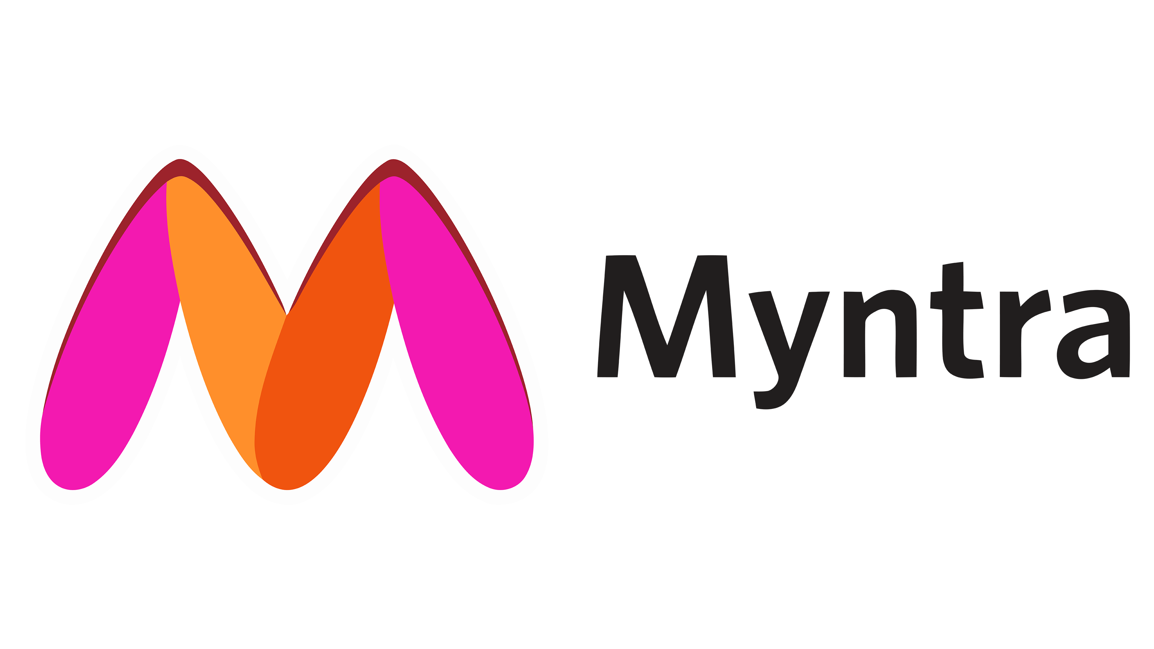


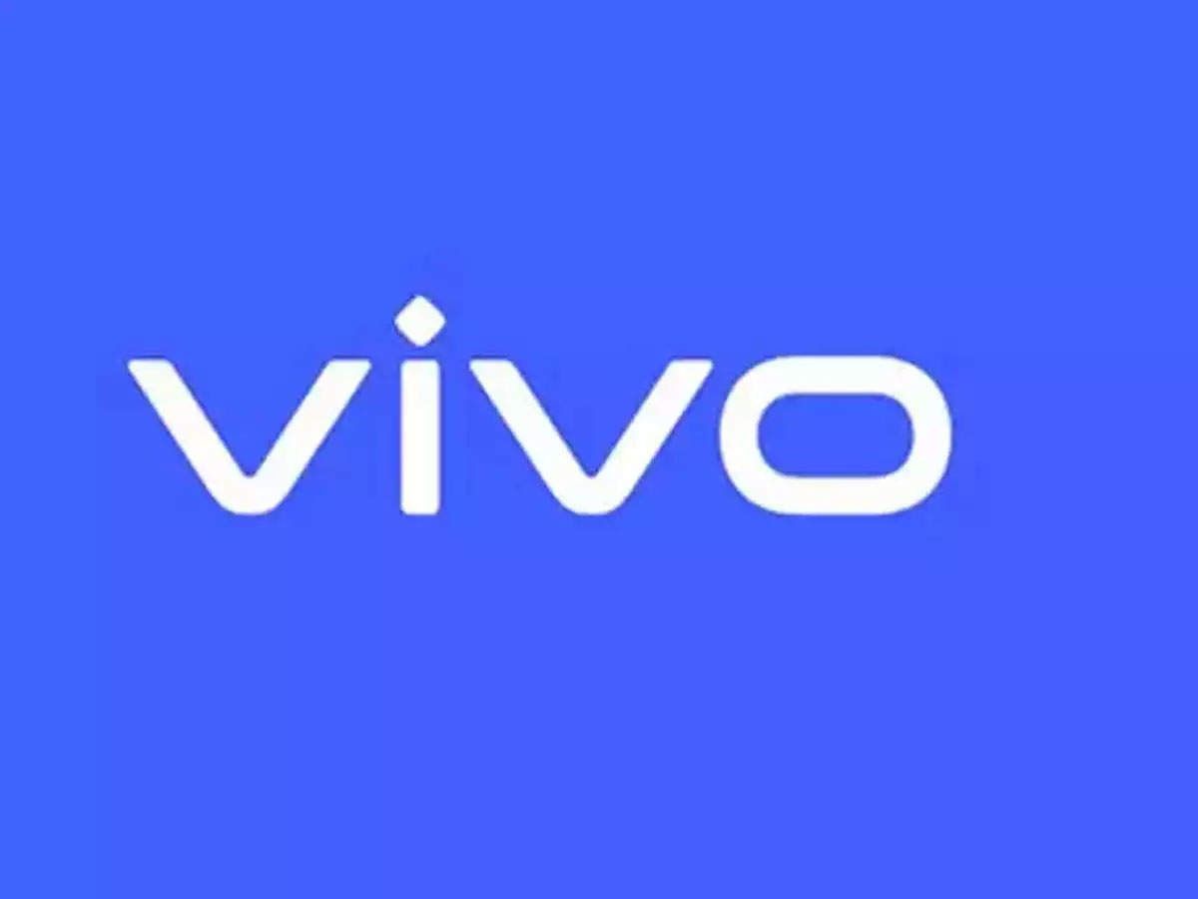
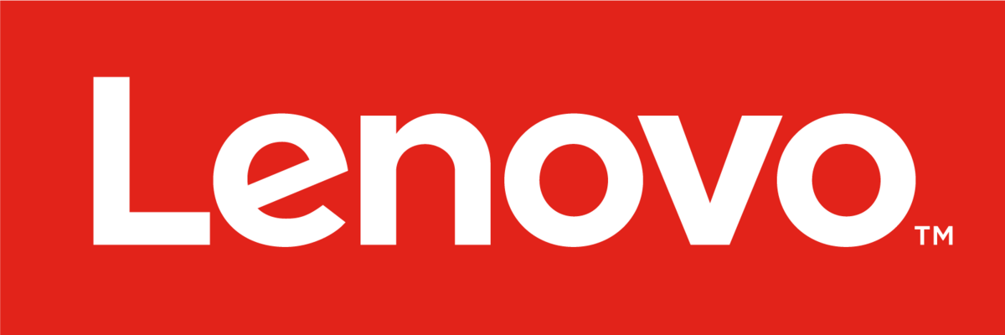



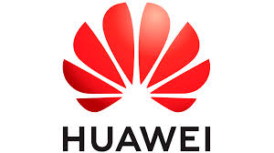




Expanding Creator Talent Pool of Clout (supply-side)
Influencer Market Growth Story So Far
Current roaster of Clout
1875 Crore
56%
Brands invest >2% of media budget on influencer marketing.
India’s Growth Story
Tier wise Breakdown of Influencer Roster
Tier 1 Breakdown in Major Cities
Category wise Breakdown
Size of influencer marketing industry in 2023
47%
Brands prefer driving influencer campaigns with nano and micro influencers who have 100 to
100,000 followers due to low cost per reach.
1lac - 10 lac
7%
Marketers rely on subscription-based models as influencer marketing strategy
Looking Ahead
Monthly income range of 12% content creators
3375 Crore
FMCG
AUTO
Estimated size of influencer marketing industry by 2026 at 18% CAGR
E-COMM.
Categories where 40%-57% brands plan to increase spends on influencer marketing by 10% by 2026
Hot Picks
Instagram, Youtube
Top preferred platforms to consume influencer content
Lifestyle
Fashion
Beauty
86%
Creators expect over 10% hike in income over next 2 years.
82% of the current talent is driven by Actors, Entertainment and Fashion & Beauty. Expanding along those lines into South and North-East India but with the twist of regional Language can auger well as a strategy
Categories creators think will be biggest growth drivers in influencer marketing over the years
77%
Creators reported unspecified income growth in the last two years.
Rationale behind Targeting Niches
Synergy between niche influencers and brands
Nano and Micro Influencers
Regional Influencers
Tech Review Influencers
Gaming Influencers
Cost-Effective: Brands prefer micro/nano influencers for lower cost per reach.
High ROI: $10.48 ROI for regional campaigns vs. $5.78 for global.
Gap in Roster: Clout lacks tech review influencers . Can use as a growth opportunity.
Audience Demographics: Gaming influencers reach a large 18-34 yrs old younger audiences.
Brands can use nano and micro-influencers for cost-effective, highly engaging, and authentic marketing.
Brands can use regional influencers to build local trust and connect with cultural preferences, boosting loyalty and engagement.
High Engagement: Nano influencers have the highest engagement rates.
Localised Trust: 70% of Indians find regional language content more reliable.
Consumer Trust: 69% trust influencer recommendations over brand content.
Reliability: 67% of gamers trust recomm. from gaming influencers over traditional advertising.
Growing Preference: 53.8% of brands engage nano influencers (May 2024).
Brand Preference: 44% of brands prefer regional influencers in 2024.
Engagement Rates: Tech influencers achieve nearly 2x the median engagement rate.
High Engagement Rates: Gaming influencers often achieve engagement rates of 2% to 10%
Budget Shift: 24.9% of marketers reallocated budgets from macro to micro/nano influencers .
Leverage Music Catalogue: Can inc. their content with Saregama's 150,000+ songs (15 languages)
Targeted Reach: 51% of Gen Z purchase gadgets based on tech reviews.
Massive Reach: Influencers in the gaming industry can reach millions
Tech brands can use influencer recommendations to build trust and highlight features, appealing to tech-savvy audiences.
Gaming titles can engage influencers to boost community interaction and player acquisition, enhancing brand visibility.

Slide 2













Maximizing Impact: Marketing Activation and Profit Strategies
Journey with Clout making Profits for brands and creators
Leveraging online and offline marketing Channels
Online Activations
Offline Activations
Initial Onboarding
Brand Development
Strategic Collaborations
Online Activities
Enables brands to launch more effective campaigns. Early training and platform guidance help niche influencers monetize faster.
Influencer-brand collaborations expand reach, boost revenue, increase conversions through trust and authenticity.
Activations
Goals and Addressal
Activations
Goals and Addressal
A strong brand identity helps niche influencers earn more. Brands gain higher engagement and ROI.
Creator Collaboration Challenges
Expand reach through cross-promotion. Builds a loyal audience.
Creator Festivals
Strengthen community and brand partnerships. Building partnerships and staying relevant.
Interactive Live Streams
Enhance engagement through direct interaction. Maintains authenticity and credibility.
Pop-Up Experience Zone
Enhance brand loyalty through direct engagement. Audience connection.
Performance Evaluation
Long-term growth
Audience Engagement
Regular performance assessment helps optimize campaigns and maximizes ROI for both brands and influencers.
Sustainable growth strategies help influencers diversify income .
Build long-term partnerships with brands, benefiting both parties.
Engagement with audience boosts follower loyalty, retention, & revenue for influencers. Brands also benefit from increased customer lifetime value.
AR Filters
Increase engagement with interactive tools. Keeps updated with the trends.
Creator Retreats
Improve skills and strategy. Time management and content balance.
Creator Spotlight Series
Boost visibility and relevance. Gives audience growth and credibility.
Community Service Initiatives
Build a positive brand image. Authenticity and credibility.
Business Model Analysis of Major Players
Recommended Model
Takeaways for Clout
Platform
Special Focus on niche talents would help make a mark against competition. This would assist expansion in new geographies
What does the platform provide?
Connects brands with 1,25,000+ niche influencers.
Manages campaigns, influencer discovery, provides analytics.
Drives authentic engagements and targeted marketing.
Streamlines transactions and compensation.
Focuses on data insights and tech-enhanced services.
Hybrid Model - Focused Talent Management & Marketplace for brands
End to End Campaign Management
Detailed analytic insights to support creator growth across niches would add value to the existing talent relationship
Commission from brand and influencer campaigns.
Subscription fees for platform access.
Freemium model for training and consultancy.
Regional language content consumption grew by 30% in 2023, with around 70% of internet users in Tier 2 and Tier 3 cities preferring regional content.
How do they make money?
Commission from influencer-brand collaborations.
Fees for advanced analytics and performance insights.
Subscription Fees, Brand Commission
Influencer Commission – Low value targeted at Tier 2, 3 cities
Spending on digital and influencer marketing in Tier 2 and Tier 3 cities grew by 50% in 2023, reaching an estimated $600 million
What is their USP?
Extensive influencer network across categories.
Detailed campaign analytics and insights.
Tailored strategies for driving brand results.
Advanced algorithms for optimal influencer-brand fit.
Comprehensive analytics for campaign performance.
Streamlined payment and administrative processes.
Market Expansion – Focus of Regional Content; Tier 2,3 cities
Brand Spotlight for Niche Influencers
CAGR of 12% in the Gaming space for 4 years (2022-2026) makes the space prospective for further growth

